Slide 1
Cyclic Codes
Prepared by
Prof. Hitesh Dholakiya
Modified by
Rifat Rahman
Assistant Professor
Institute of Appropriate Technology, BUET
https://rrahman007.buet.ac.bd

Slide 2
Cyclic Codes
Basics of Cyclic Code
Cyclic Code is a Type of Linear Block Code with Cyclic Properties.
Properties of Cyclic Code
Linearity Property
If we have two Cyclic Codewords Ci and Cj, then their sum Cp = Ci + Cj is also a
Codeword.
Cyclic Property
After performing a cyclic shift on any codeword, the result is also a valid codeword.

Slide 3
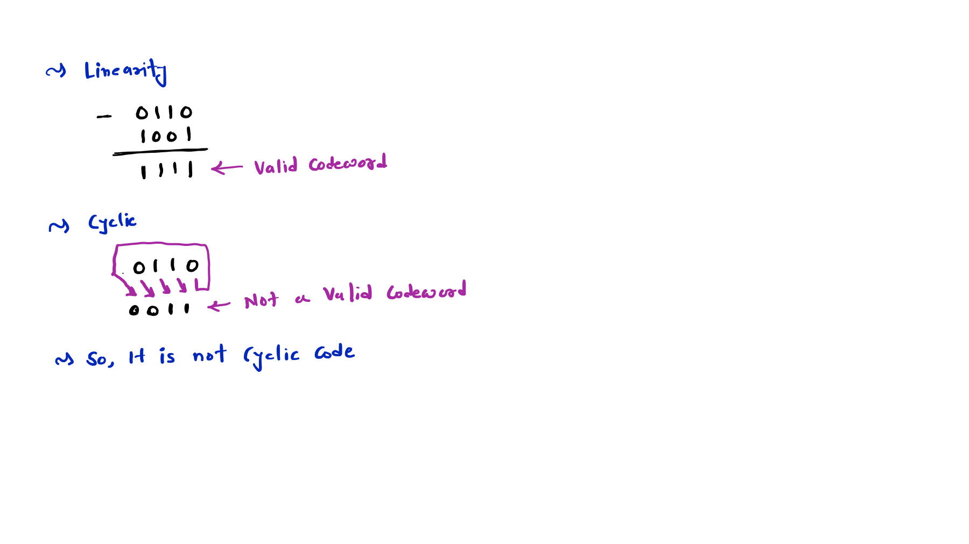
Example 1: [0000, 0110, 1001, 1111], Is it a Cyclic Code?

Slide 4
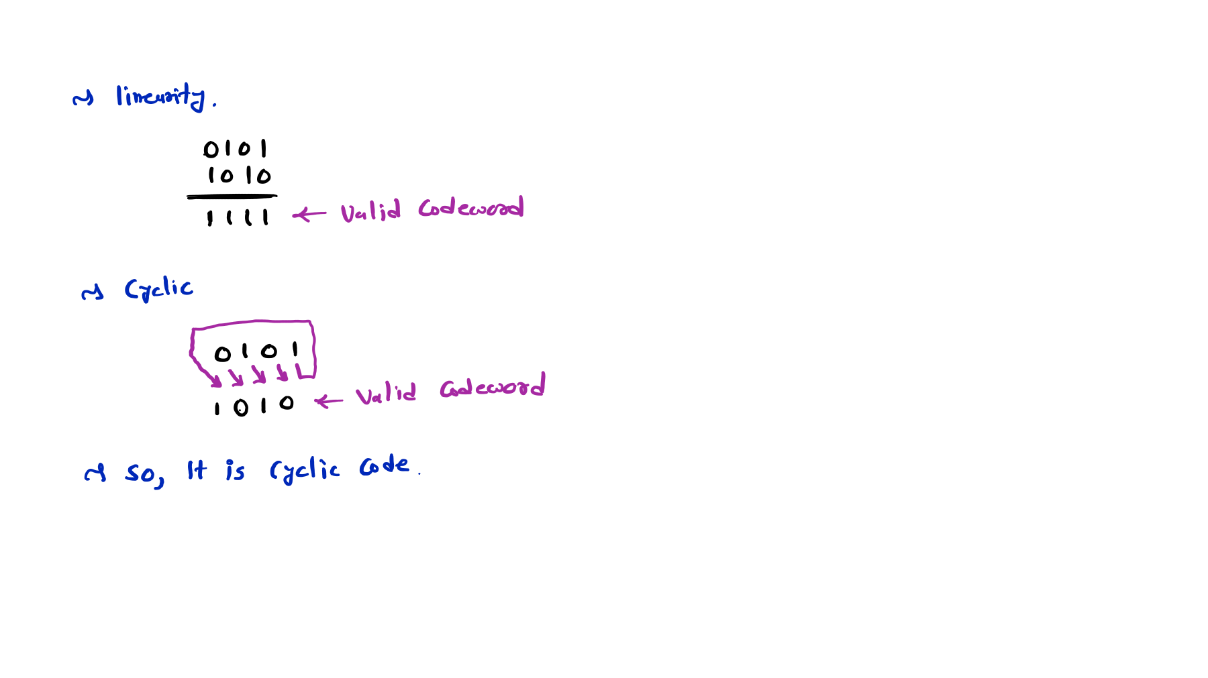
Example 2: [0000, 0101, 1010, 1111], Is it a Cyclic Code?

Slide 5
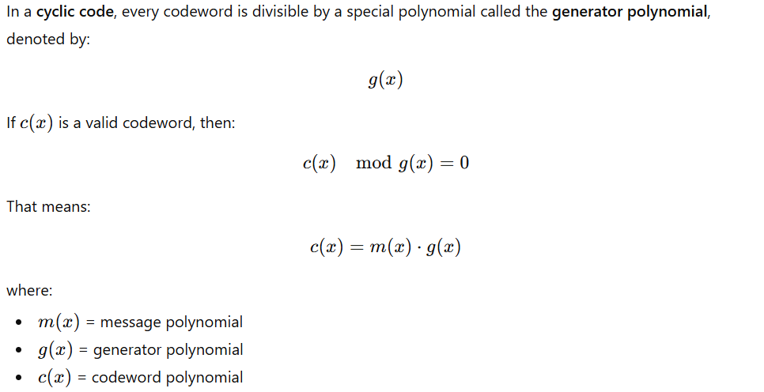
Generator Polynomial
Source: chatgpt

Slide 6
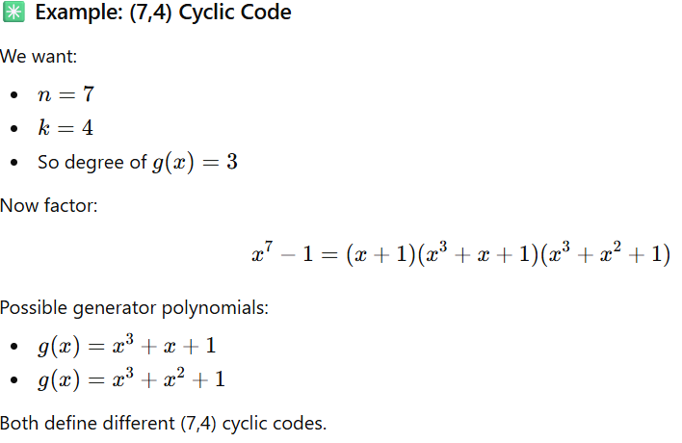
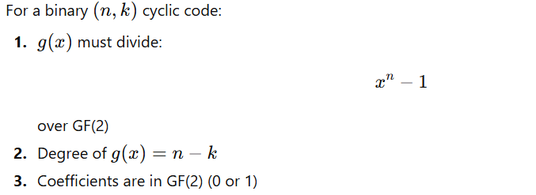

Generator Polynomial
Source: chatgpt

Slide 7
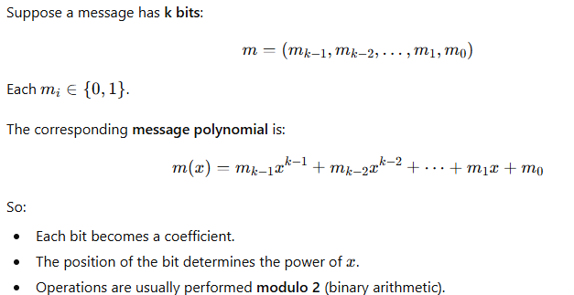
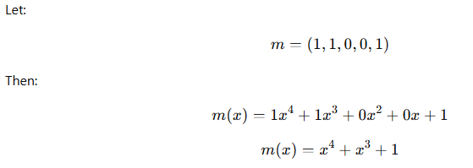
Message Polynomial
Source: chatgpt

Slide 8
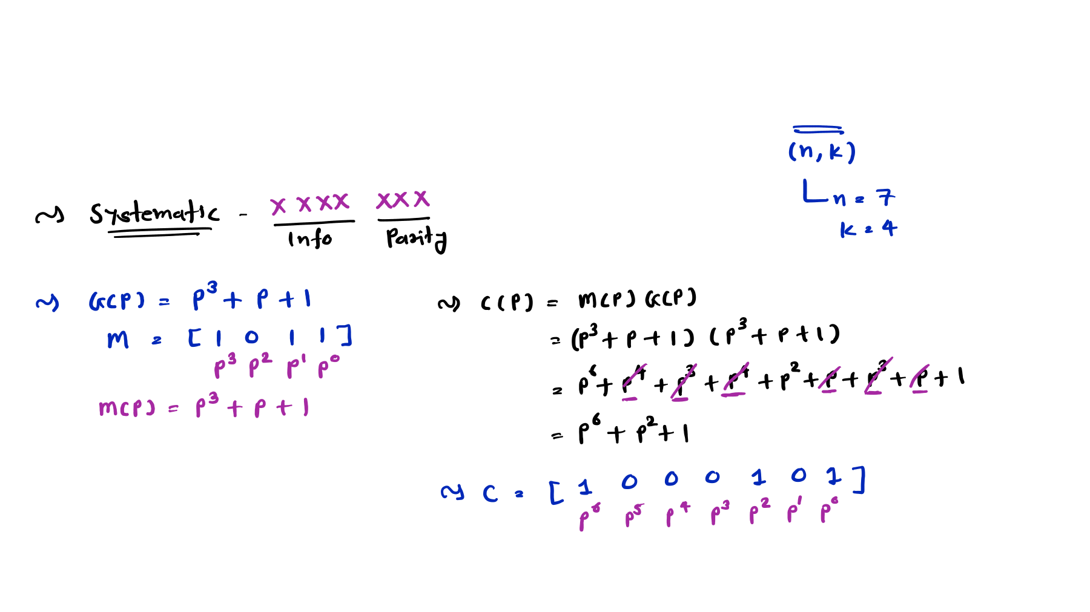
Non-Systematic Cyclic Code
Example 1: Find code vector for the Non-Systematic Cyclic Code (7, 4) with the Generator polynomial 𝐆 𝐏 = 𝐏^{𝟑} + 𝐏 + 𝟏 and the Message M = [1 0 1 1]

Slide 9
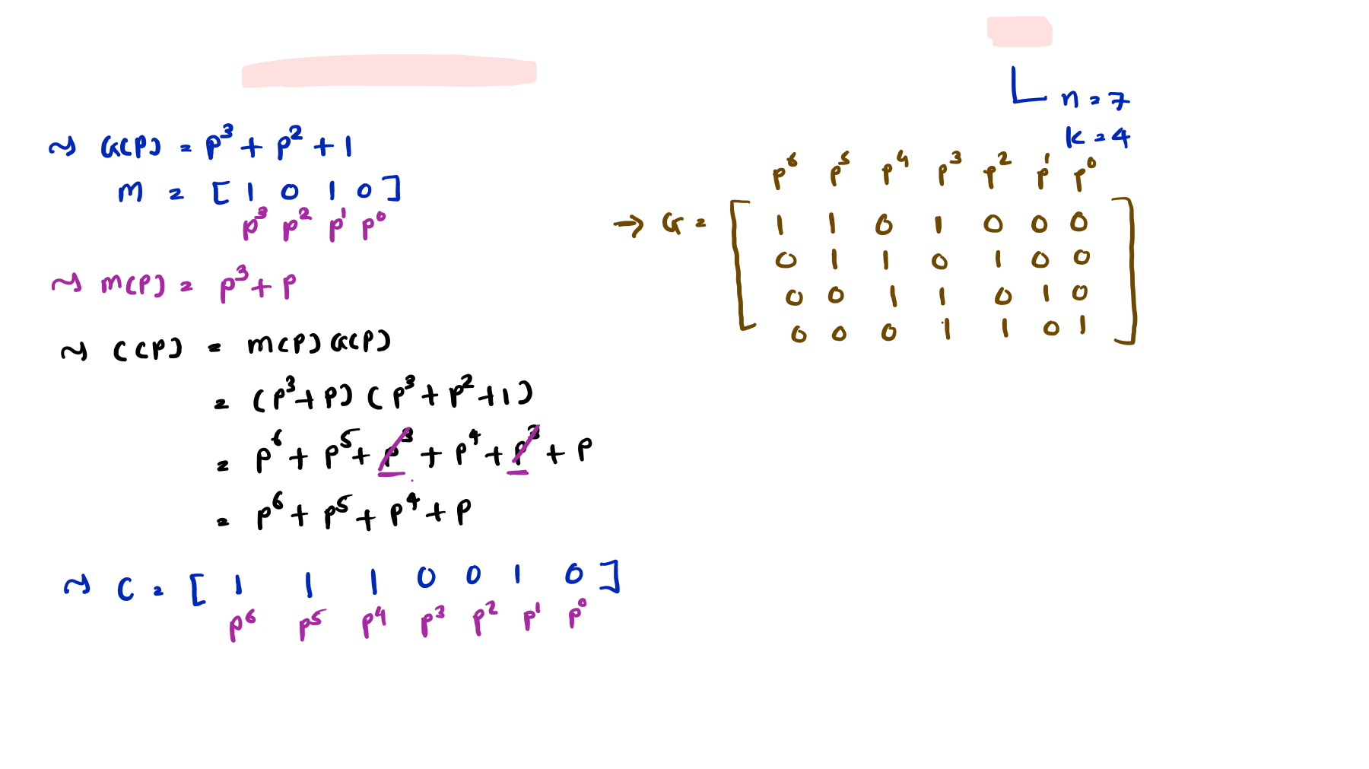
Example 2: Find code vector for the Non-Systematic Cyclic Code (7, 4) with the Generator polynomial 𝐆 𝐏 = 𝐏^{𝟑} + 𝐏^{𝟐} + 𝟏 and the Message M = [1 0 1 0]

Slide 10
Systematic Cyclic Code
Basics of Systematic Cyclic Code
Format of Systematic Cyclic Code (n, k) is given by:
⟹ 𝐂𝐨𝐝𝐞𝐰𝐨𝐫𝐝 = [𝐌𝐞𝐬𝐬𝐚𝐠𝐞 𝐛𝐢𝐭𝐬 (𝐤 𝐛𝐢𝐭𝐬), 𝐏𝐚𝐫𝐢𝐭𝐲 𝐛𝐢𝐭𝐬 (𝐧 − 𝐤 𝐛𝐢𝐭𝐬)]
Codeword of Systematic Cyclic Code is given by:
⟹ 𝐂 𝐱 = 𝐱^{𝐧−𝐤}𝐦 𝐱 + 𝐩 𝐱
C(x) = Codeword Polynomial
m(x) = Message Polynomial
p(x) = Parity Polynomial
Parity Polynomial p(x) of Systematic Cyclic Code is given by:
_{𝐱}𝐧−𝐤_{𝐦 𝐱}
⟹ 𝐩 𝐱 = 𝐑𝐞𝐦
𝐠 𝐱
g(x) = Generator Polynomial

Slide 11
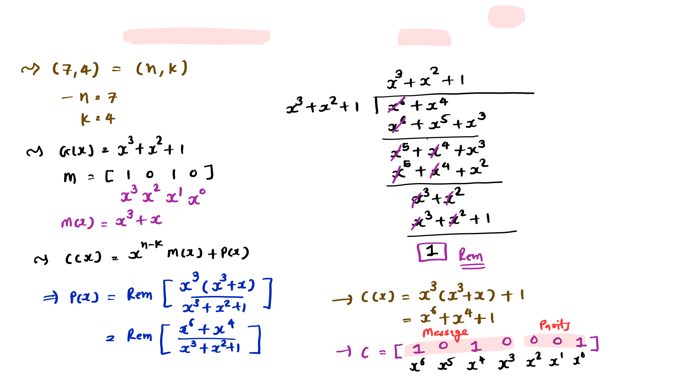
Example 1: Find code vector for the Systematic Cyclic Code (7, 4) with the Generator Polynomial 𝐆 𝐱 = 𝐱^{𝟑} + 𝐱^{𝟐} + 𝟏 and the message [1 0 1 0].

Slide 12

Generator Matrix of Systematic Cyclic Code
Basics of Generator Matrix of Systematic Cyclic Code
Generator Matrix G:
⟹ 𝐆 = [𝐈𝐝𝐞𝐧𝐭𝐢𝐭𝐲 𝐈 (𝐤 𝐛𝐢𝐭𝐬), 𝐏𝐚𝐫𝐢𝐭𝐲 𝐏 (𝐧 − 𝐤 𝐛𝐢𝐭𝐬)]
For Cyclic Code (n, k), then the Generator matrix G has n columns and k rows.
I = Identity is k x k Matrix
P = Parity is k x (n-k) Matrix
Row of Parity Matrix can be calculated by:
_{𝐱}𝐧−𝟏
⟹ 𝟏𝐬𝐭 𝐑𝐨𝐰 = 𝐑𝐞𝐦
𝐠 𝐱
_{𝐱}𝐧−𝟐
⟹ 𝟐𝐧𝐝 𝐑𝐨𝐰 = 𝐑𝐞𝐦
𝐠 𝐱
……………
_{𝐱}𝐧−𝐤
⟹ 𝐤𝐭𝐡 𝐑𝐨𝐰 = 𝐑𝐞𝐦
𝐠 𝐱

Slide 13
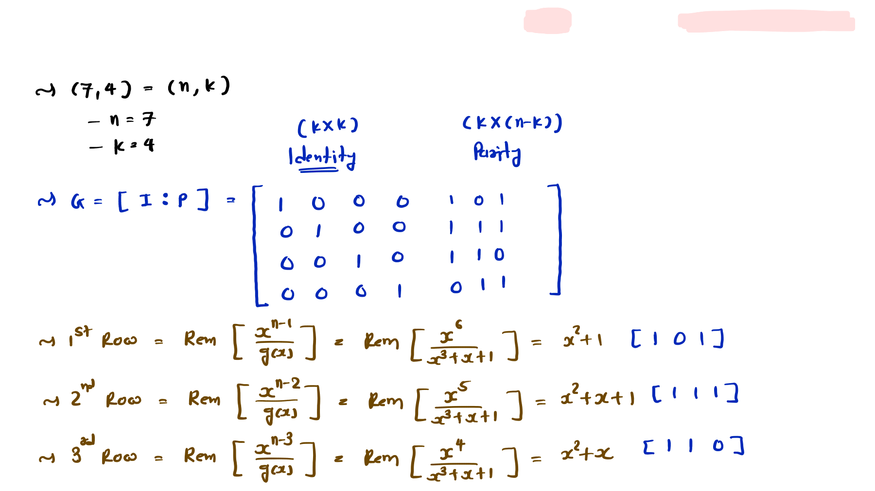
Example 1: The Generator Polynomial of Cyclic Code (7, 4) is given by 𝐆 𝐱 = 𝐱^{𝟑} + 𝐱 + 𝟏. Then Construct Generator Matrix.

Slide 14
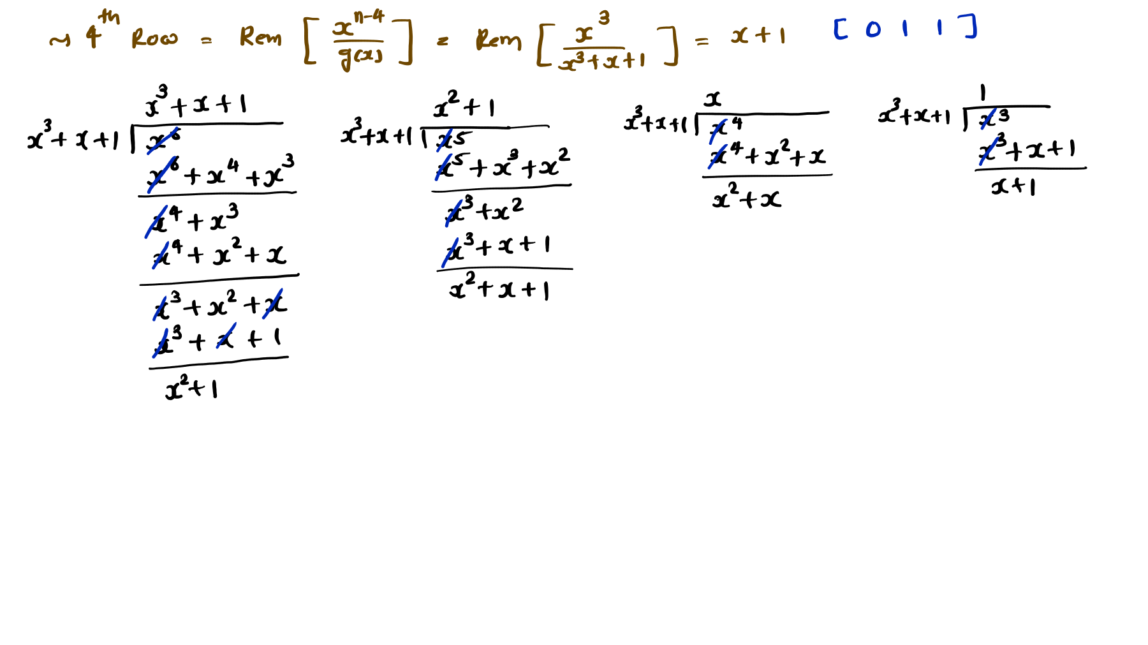

Slide 15
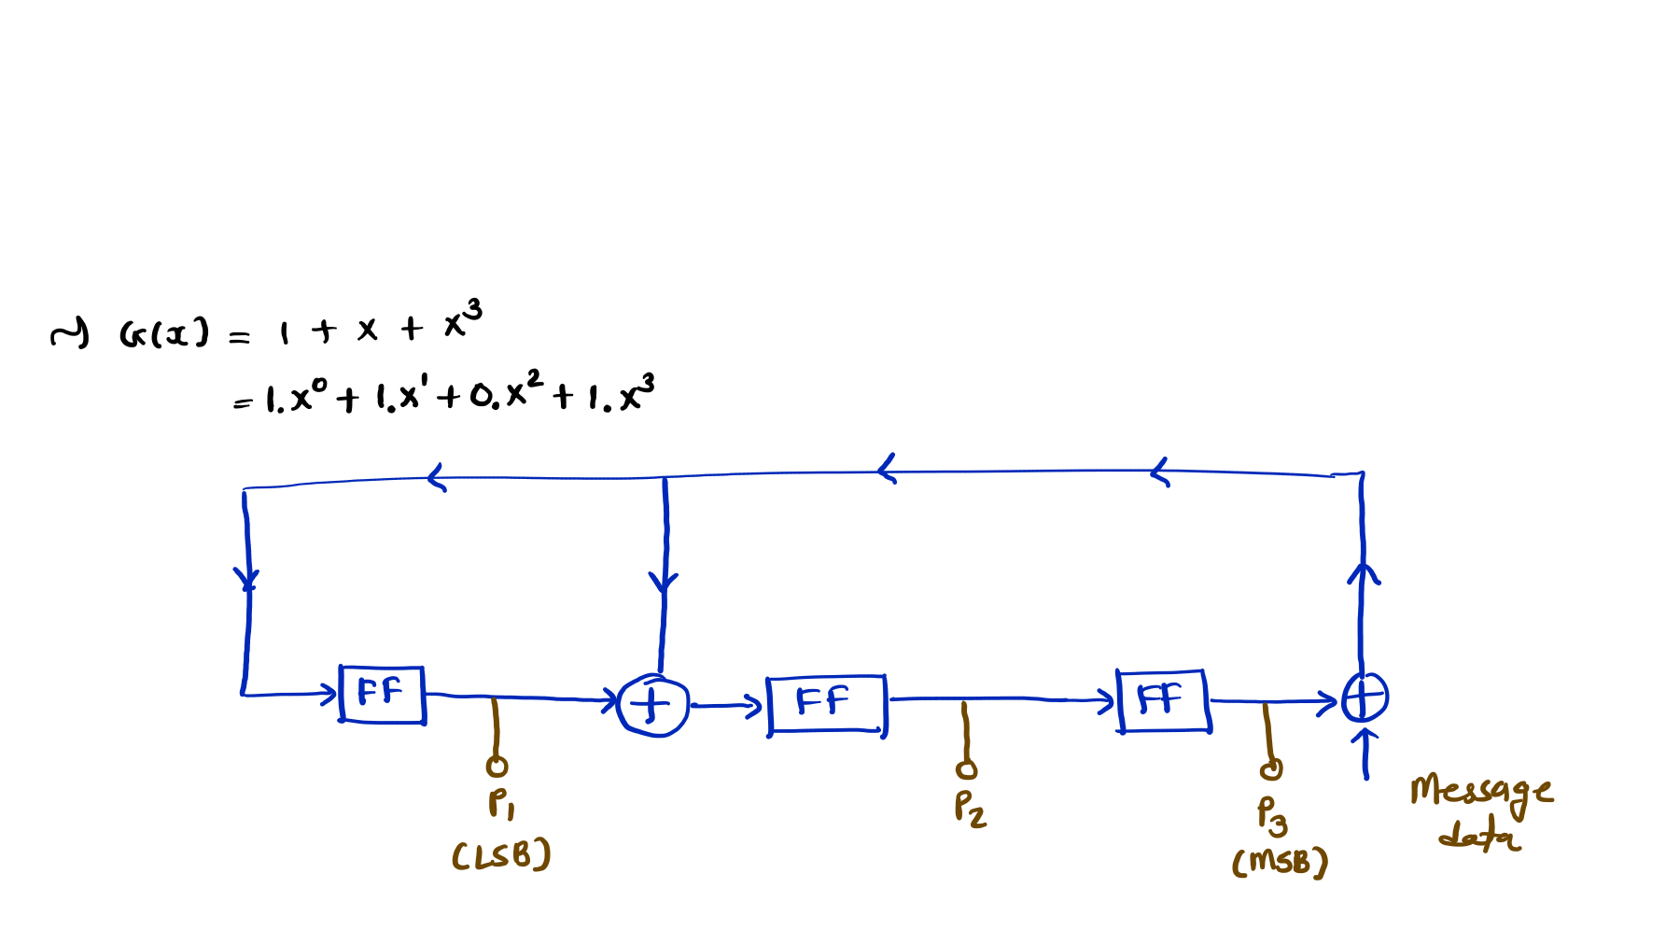
Designing of Cyclic Encoder
Example 1: The Generator Polynomial of Cyclic Code (7, 4) is given by 𝐆 𝐱 = 𝐱^{𝟑} + 𝐱 + 𝟏.
Design Cyclic Encoder Circuit/Hardware
Find Codeword if Message is [1 1 1 0]

Slide 16
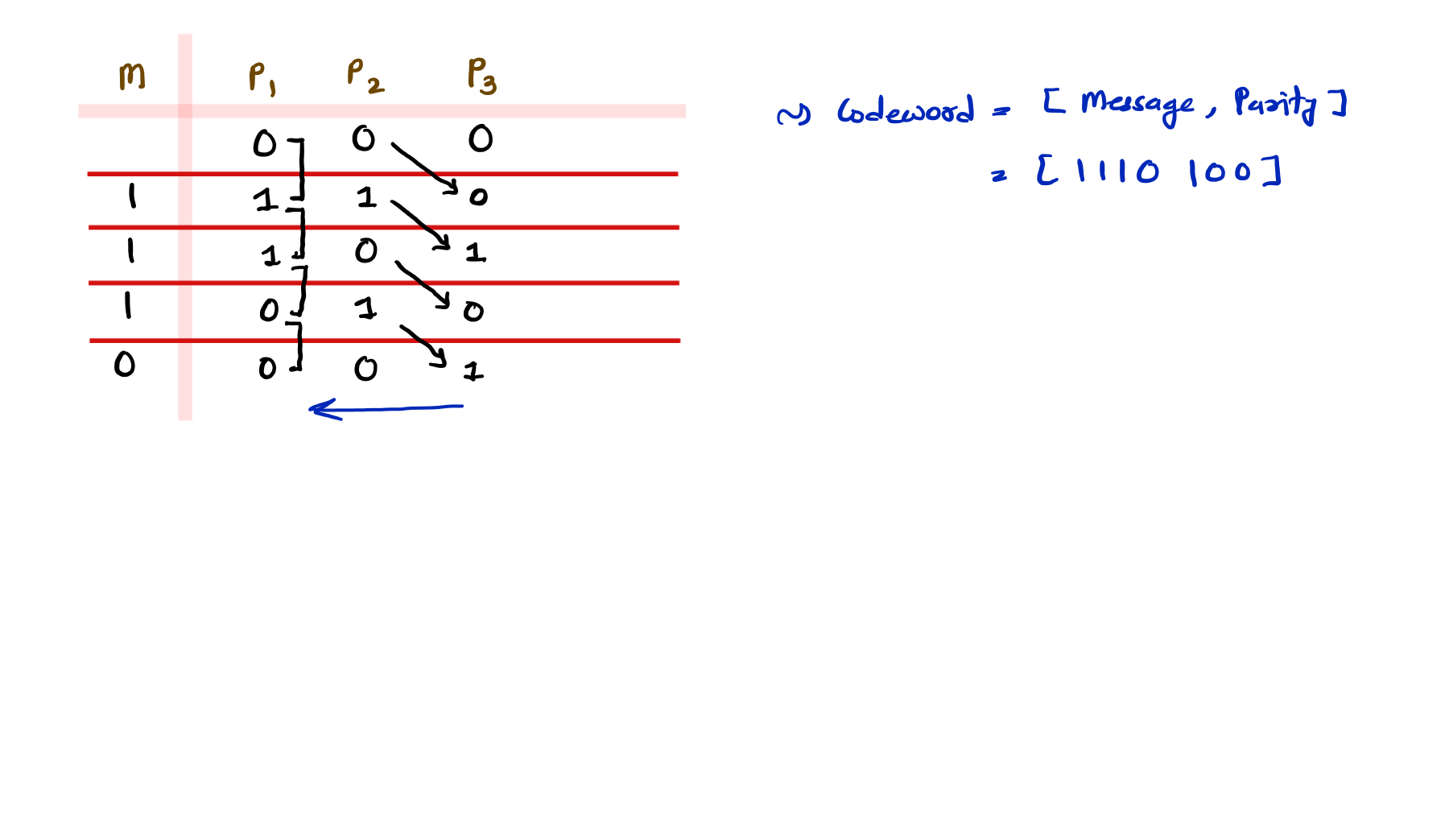

Slide 17
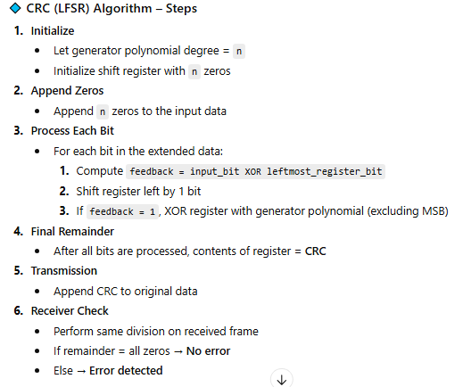
CRC (Linear Feedback Shift Register) Algorithm
Source: chatgpt

Slide 18
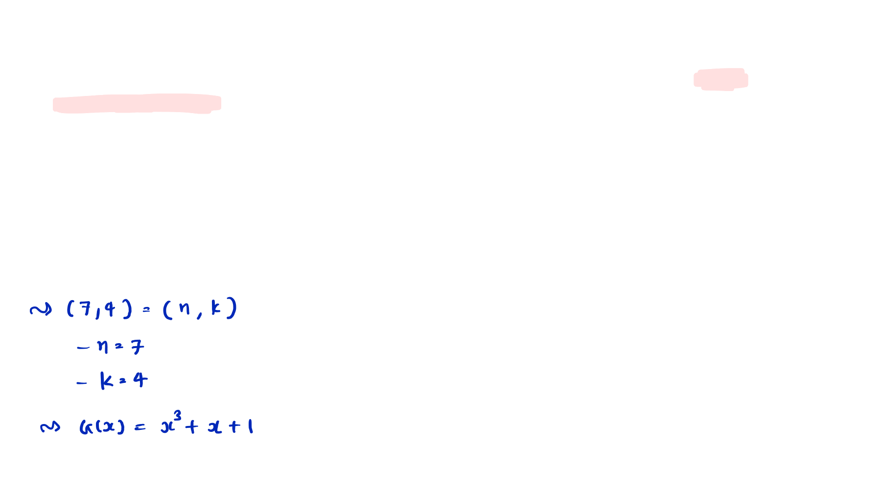
Complete Example of Cyclic Code
Example: The Generator Polynomial of the Systematic Cyclic Code (7, 4) is given by
𝐆 𝐱 = 𝐱^{𝟑} + 𝐱 + 𝟏. Calculate the following Parameters:
Generator Matrix
Codeword for Message [1 0 1 1]
Parity Check Matrix
Decoding Matrix
Syndrome Matrix if received codeword is [1 1 0 1 1 0 0]
Error Correction with above received data

Slide 19
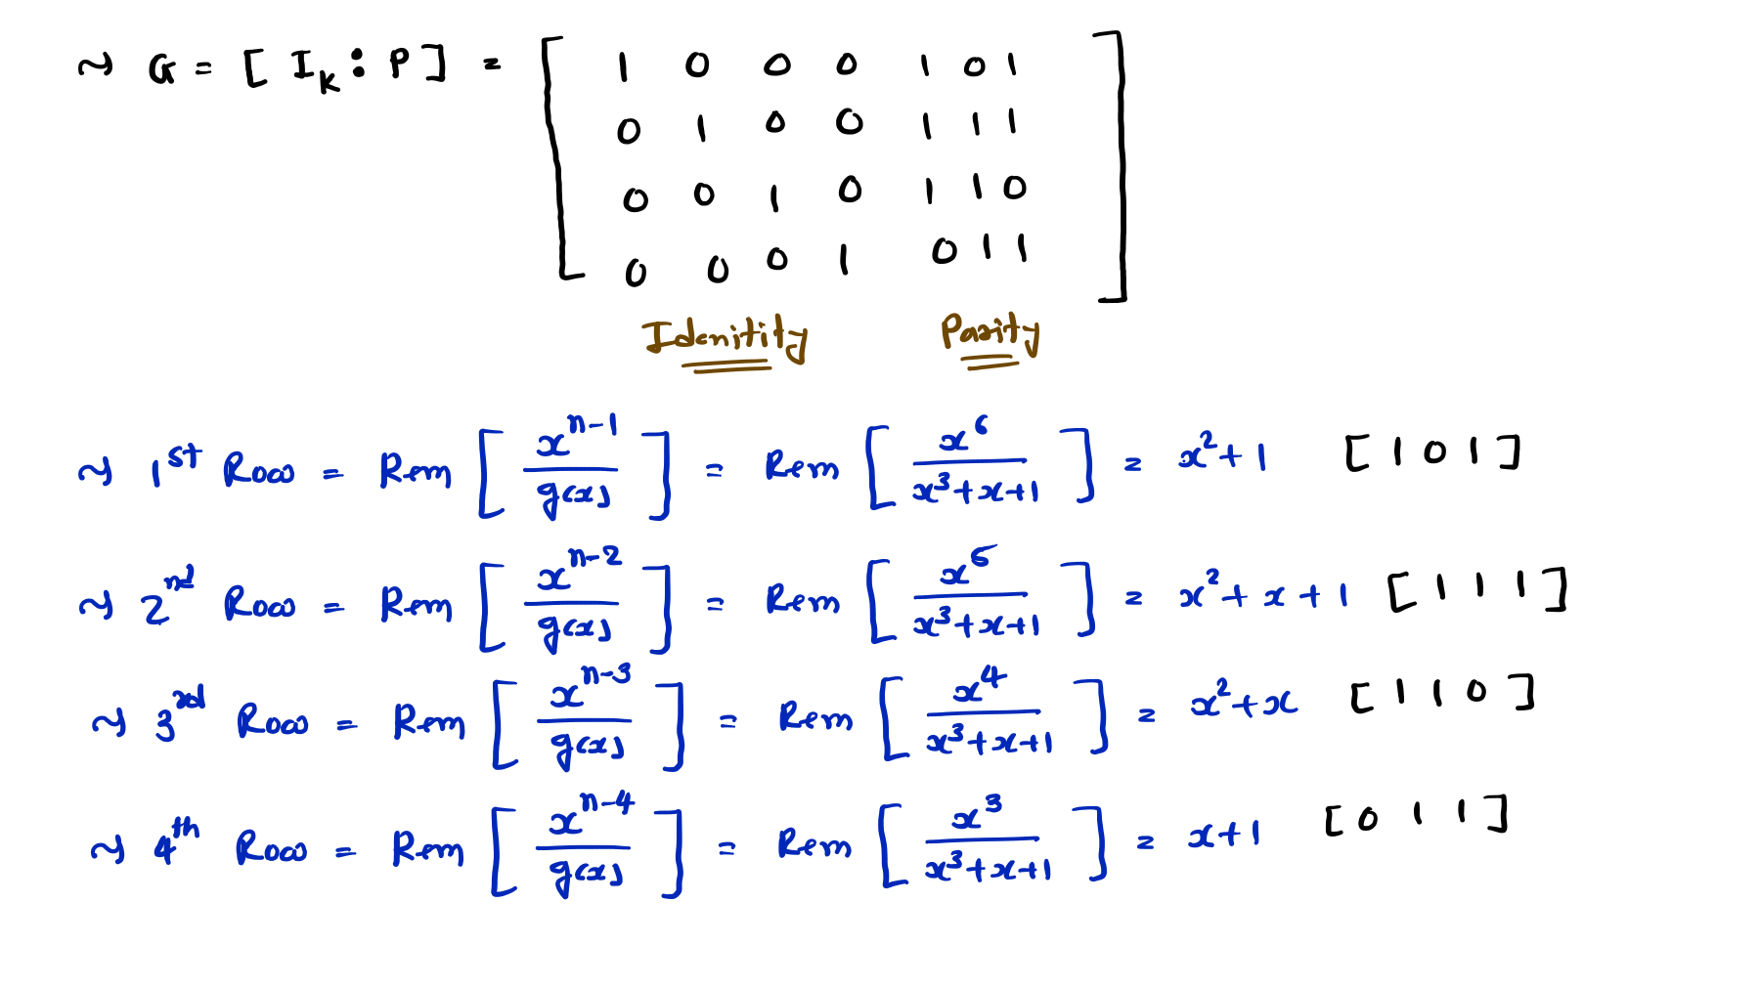

Slide 20
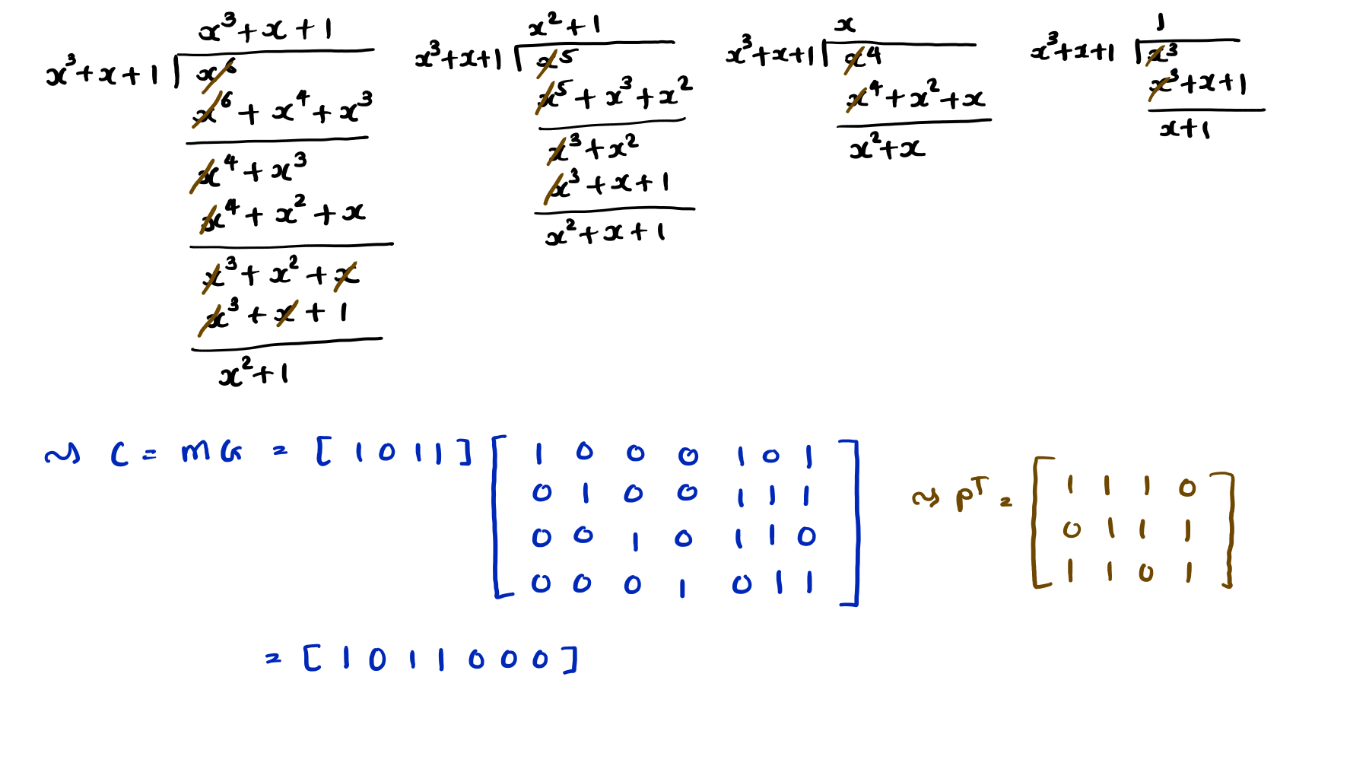

Slide 21
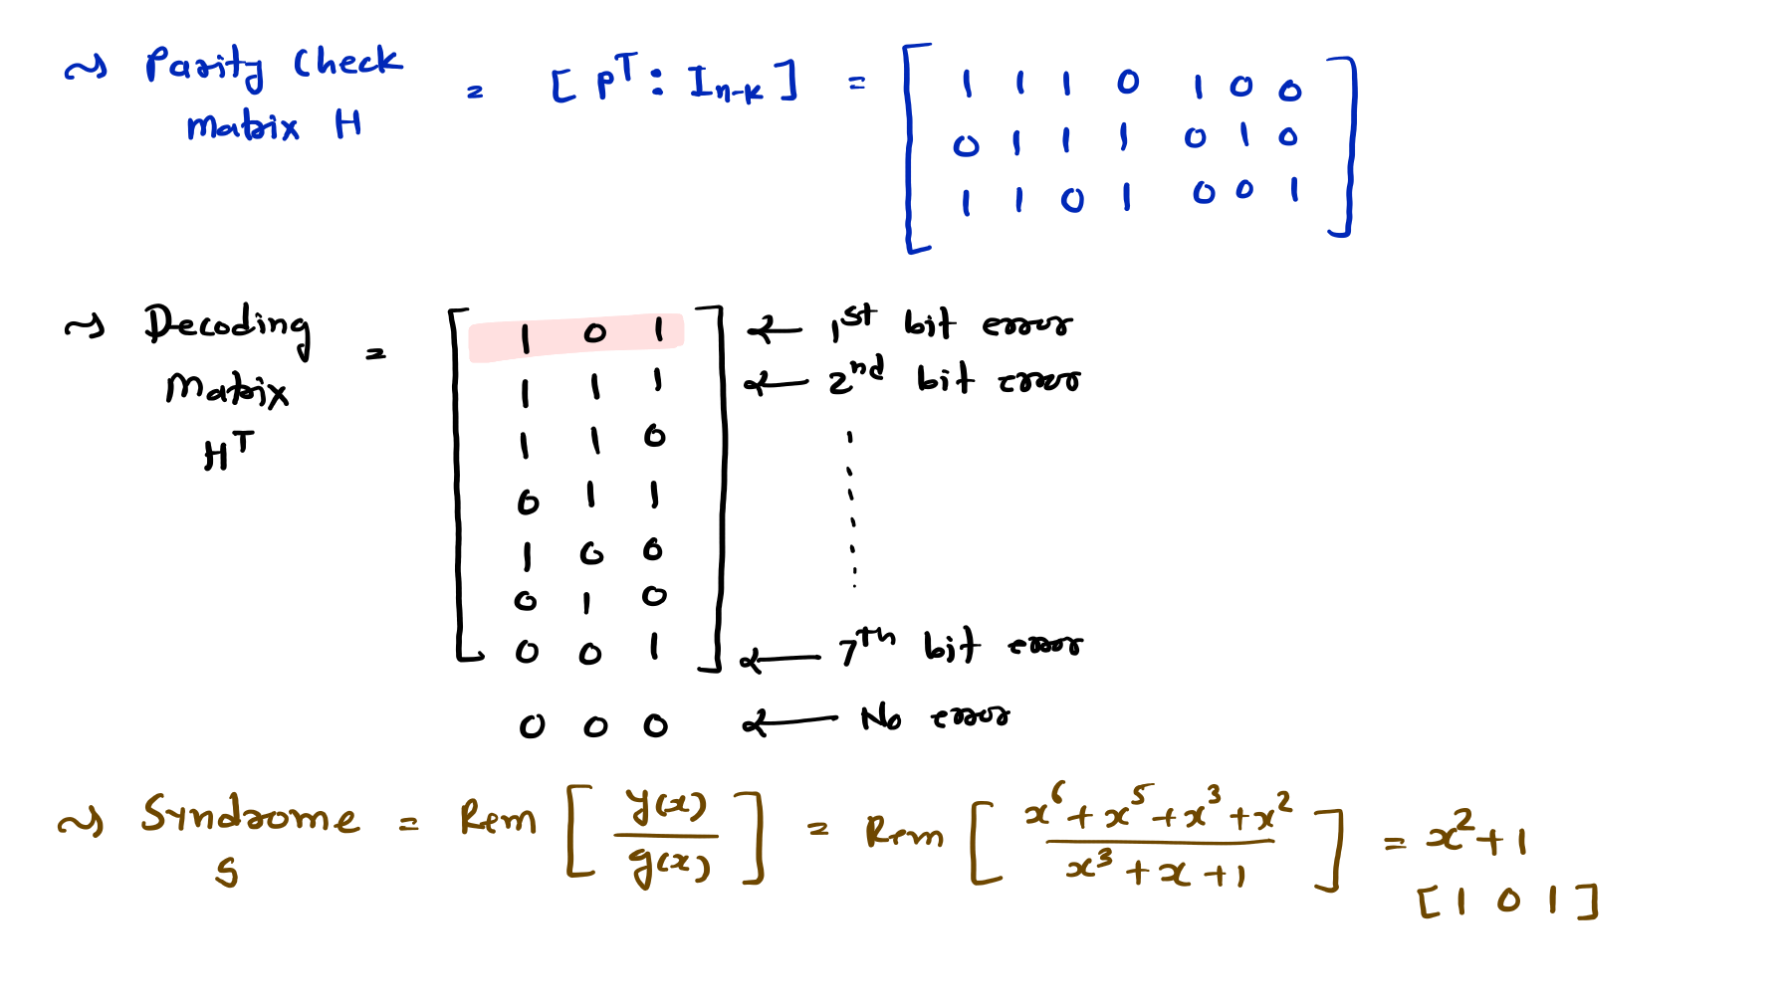

Slide 22
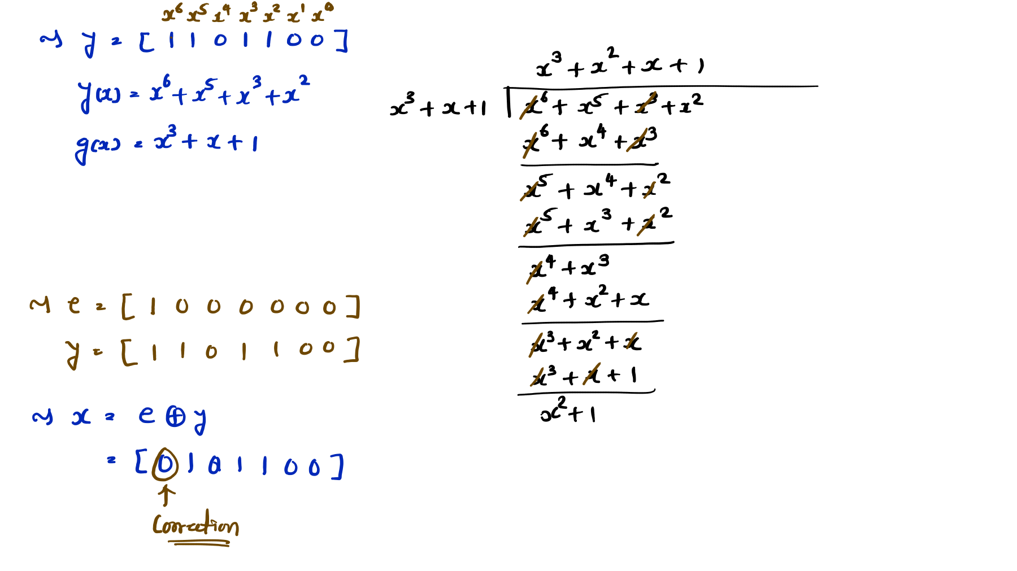

Slide 23
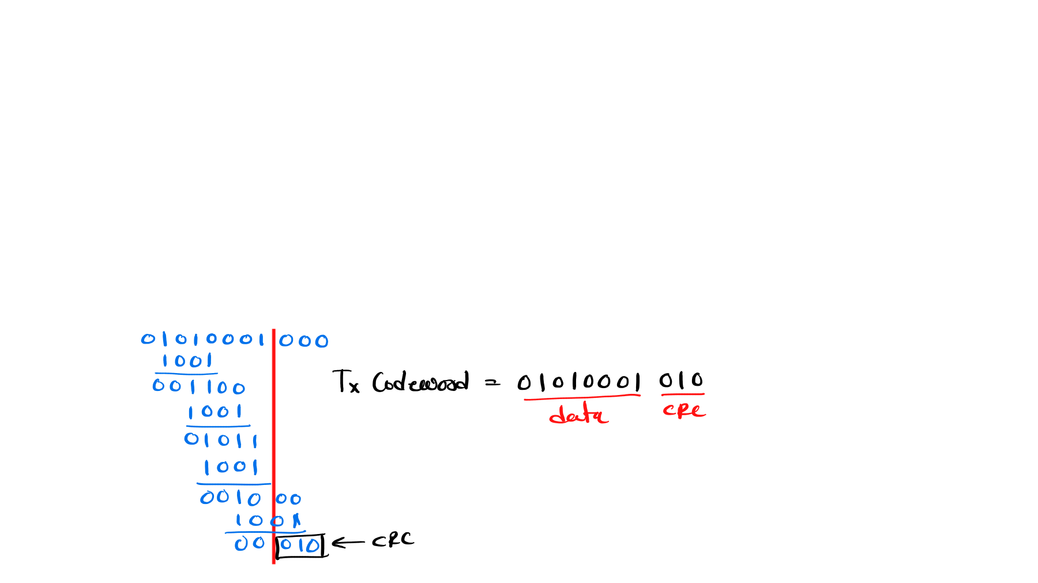
Cyclic Redundancy Check - CRC
Basics of Cyclic Redundancy Check
CRC uses a Divisor with L bits. {Divisor may be given in Galois fields.}
Here we append L – 1 bits with data bits.
Here we perform binary division for CRC generation.
Receiver and Transmitter should be agreed upon by the same Divisor.
Example of Cyclic Redundancy Check
Data = 01010001, Divisor = 1001. Find transmitted codeword using CRC.

Slide 24
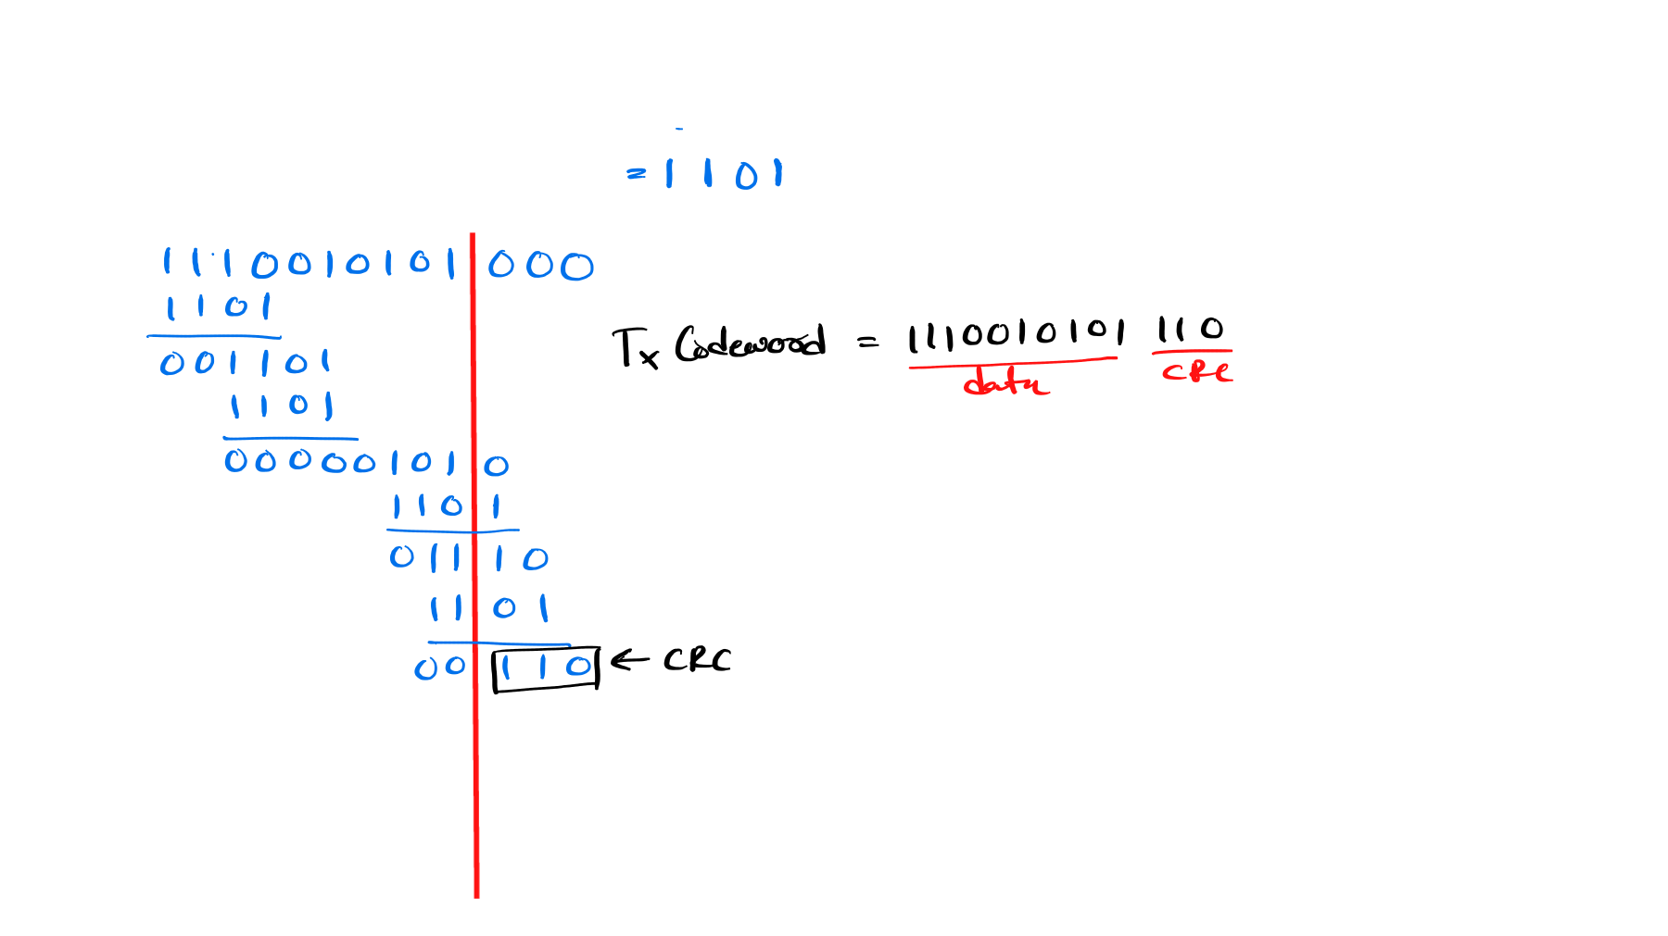
Example of Cyclic Redundancy Check
Data = 1110010101, Divisor = 𝐗^{𝟑} + 𝐗^{𝟐} + 𝟏. Find transmitted codeword using CRC.

Slide 25
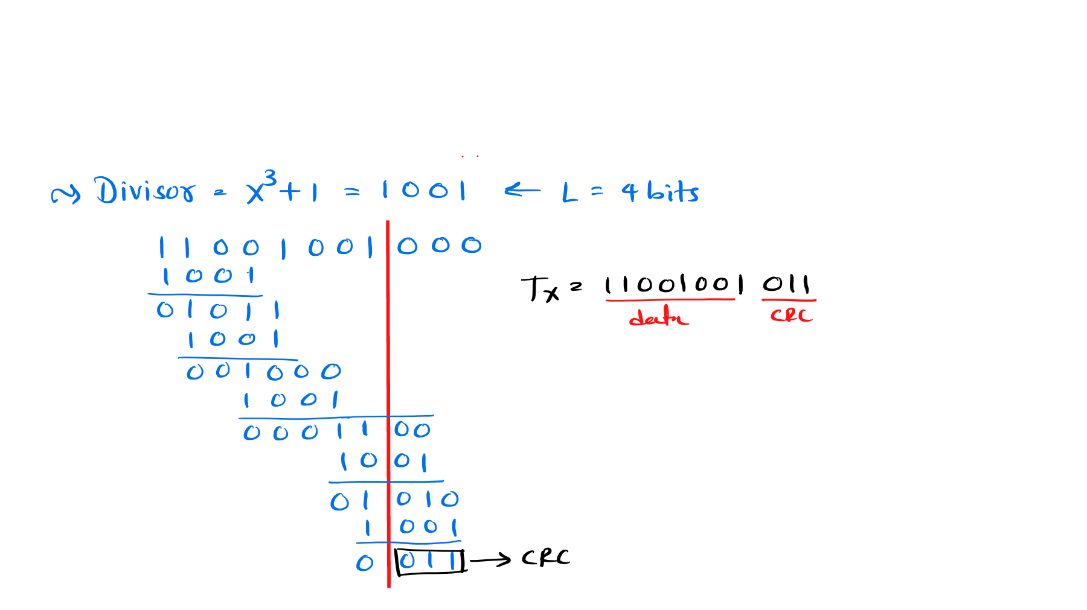
Examples on CRC – Cyclic Redundancy Check
Example 1 – The message 11001001 is to be transmitted using the CRC polynomial 𝐗^{𝟑} + 𝟏 to protect it from errors. The message that should be transmitted is …………………. If the received codeword at the receiver is 11011001011 then how the receiver will take decision?

Slide 26
